Slide 1



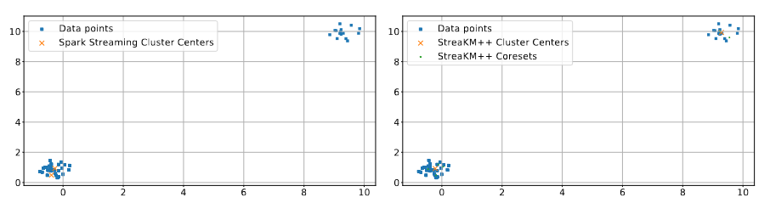

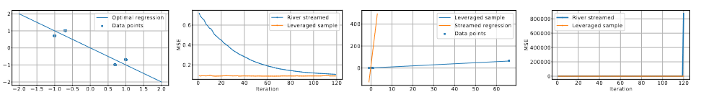
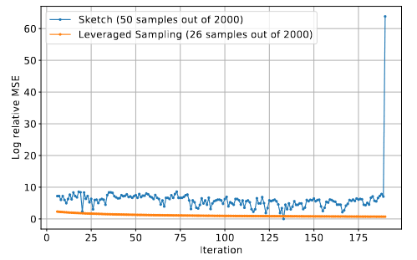
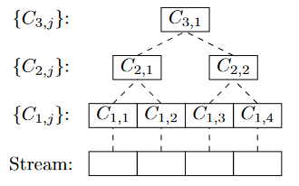
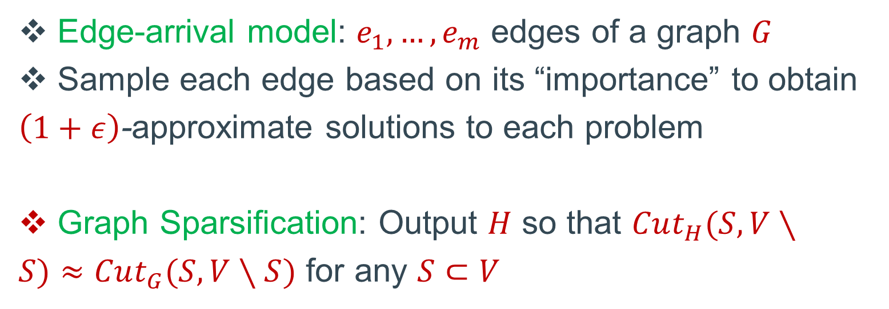
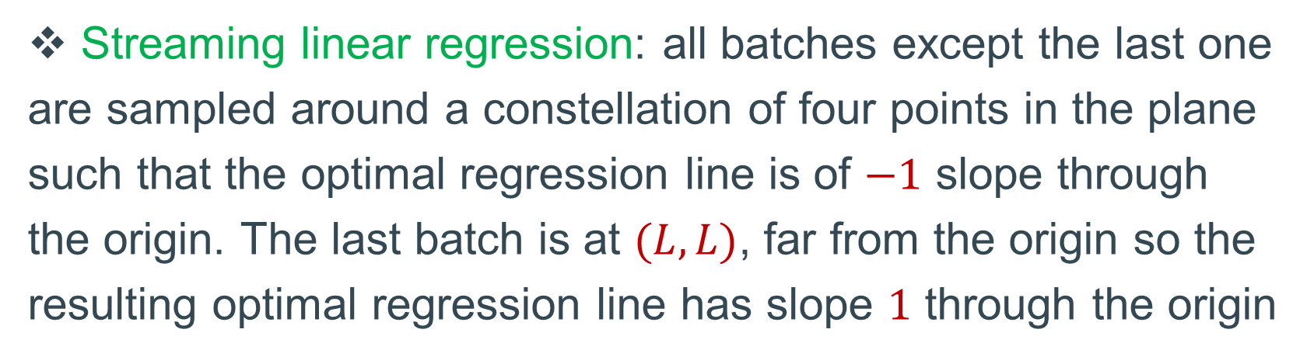
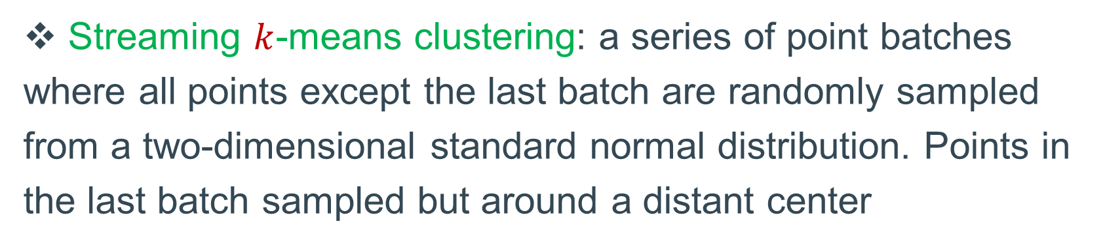
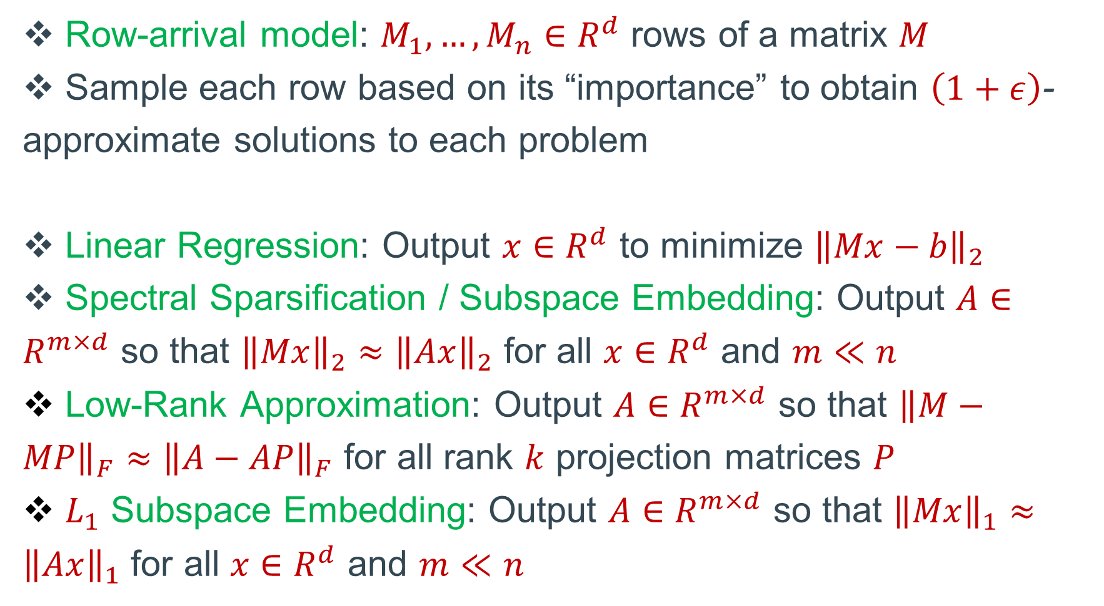
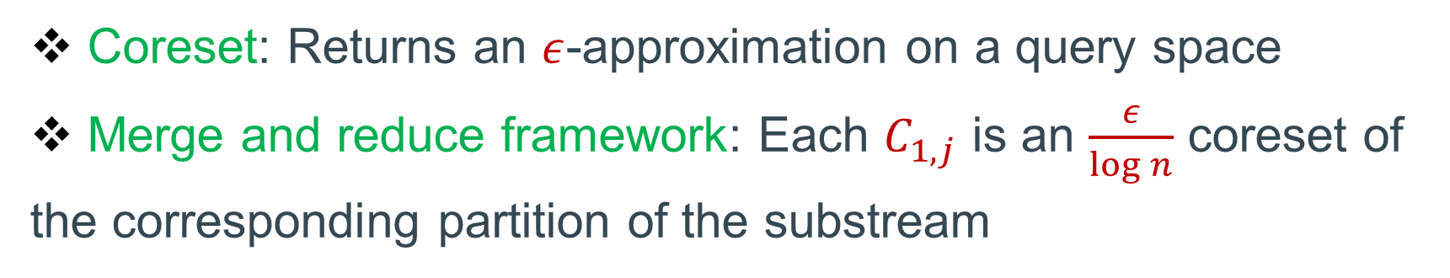
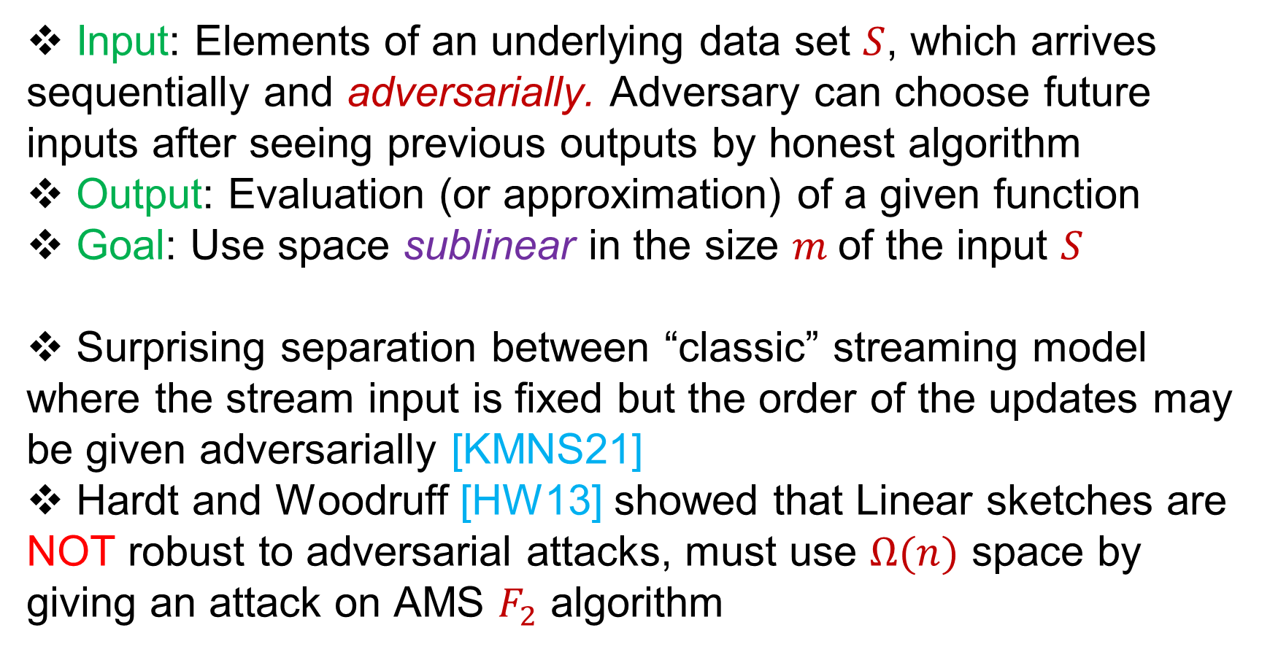
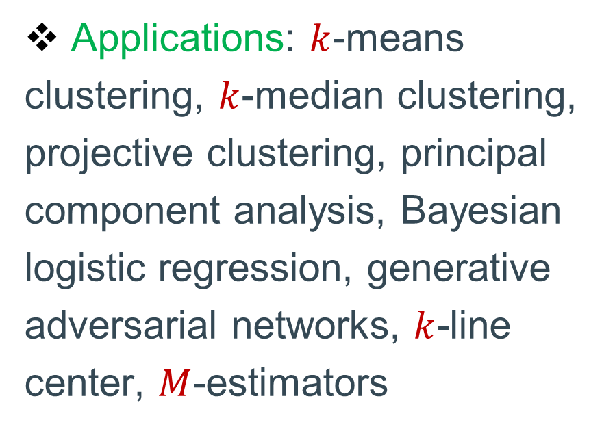
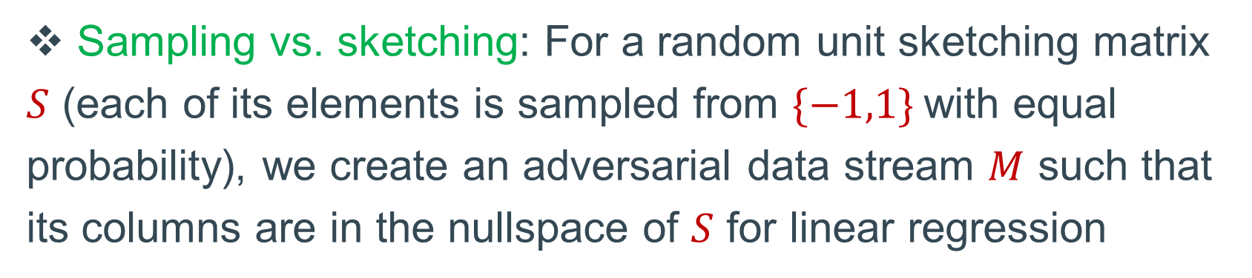
Adversarial Robustness of Streaming Algorithms through Importance Sampling
Vladimir Braverman (Johns Hopkins University, Google)
Avinatan Hassidim (Google)
Yossi Matias (Google)
Mariano Schain (Google)
Sandeep Silwal (MIT)
Samson Zhou (Carnegie Mellon University)
Empirical Evaluations
Model
Streaming $k$-means clustering: a series of point batches where all points except the last batch are randomly sampled from a two-dimensional standard normal distribution. Points in the last batch sampled but around a distant center
Input: Elements of an underlying data set $S$, which arrives sequentially and adversarially. Adversary can choose future inputs after seeing previous outputs by honest algorithm
Output: Evaluation (or approximation) of a given function
Goal: Use space sublinear in the size $m$of the input $S$
Surprising separation between “classic” streaming model where the stream input is fixed but the order of the updates may be given adversarially [KMNS21]
Hardt and Woodruff [HW13] showed that Linear sketches are NOT robust to adversarial attacks, must use $Ω(n)$ space by giving an attack on AMS $F_{2}$ algorithm
Row Sampling Algorithms for Linear Algebra
Row-arrival model: $M_{1},…, M_{n}∈R^{d}$ rows of a matrix $M$
Sample each row based on its “importance” to obtain $\left(1+ε\right)$-approximate solutions to each problem
Linear Regression: Output $x∈R^{d}$ to minimize ${\left\|Mx−b\right\|}_{2}$
Spectral Sparsification / Subspace Embedding: Output $A∈R^{m×d}$ so that ${\left\|Mx\right\|}_{2}≈{\left\|Ax\right\|}_{2}$ for all $x∈R^{d}$ and $m≪n$
Low-Rank Approximation: Output $A∈R^{m×d}$ so that ${\left\|M−MP\right\|}_{F}≈{\left\|A−AP\right\|}_{F}$ for all rank $k$ projection matrices $P$
$L_{1}$ Subspace Embedding: Output $A∈R^{m×d}$ so that ${\left\|Mx\right\|}_{1}≈{\left\|Ax\right\|}_{1}$ for all $x∈R^{d}$ and $m≪n$
Streaming linear regression: all batches except the last one are sampled around a constellation of four points in the plane such that the optimal regression line is of $−1$ slope through the origin. The last batch is at $(L,L)$, far from the origin so the resulting optimal regression line has slope $1$ through the origin
Applications / Motivations
Adversarial machine learning: ML problems where the input is chosen by an adversary
Database queries: For multiple queries to a database, each query may depend on the responses to the previous queries
Transparency of Algorithms: Internal state of honest algorithms may be entirely revealed or otherwise compromised
Edge Sampling Algorithms for Graphs
Edge-arrival model: $e_{1},…, e_{m}$ edges of a graph $G$
Sample each edge based on its “importance” to obtain $\left(1+ε\right)$-approximate solutions to each problem
Graph Sparsification: Output $H$ so that $Cut_{H}(S,V∖S)≈Cut_{G}(S,V∖S)$ for any $S⊂V$
Sampling vs. sketching: For a random unit sketching matrix $S$ (each of its elements is sampled from $\{−1,1\}$with equal probability), we create an adversarial data stream $M$ such that its columns are in the nullspace of $S$ for linear regression
Coresets
Coreset: Returns an $ε$-approximation on a query space
Merge and reduce framework: Each $C_{1,j}$ is an $\frac{ε}{\log{n}}$ coreset of the corresponding partition of the substream
Results and Related Work
Our result: Importance sampling based algorithms are adversarially robust!
Intuition: Importance is a robust metric and sampling based algorithms use public randomness that is independent of previous randomness
Corollary: Merge-and-reduce is adversarially robust
Corollary: Row sampling algorithms are adversarially robust
Corollary: Edge sampling algorithm is adversarially robust
Applications: $k$-means clustering, $k$-median clustering, projective clustering, principal component analysis, Bayesian logistic regression, generative adversarial networks, $k$-line center, $M$-estimators
References
[HW13] Moritz Hardt, David P. Woodruff: How robust are linear sketches to adaptive inputs? STOC 2013: 121-130
[KMNS21] Haim Kaplan, Yishay Mansour, Kobbi Nissim, Uri Stemmer: Separating Adaptive Streaming from Oblivious Streaming. CRYPTO 2021

